Slide 1
AI & Cybersecurity
Giancarlo Buono
Regional Director Safety & Flight Operations, Europe

Slide 2

AI and Cybersecurity
AI and cybersecurity closely related
Challenges/opportunities for cybersecurity from AI: defense and offense
Leverage AI benefits - mitigating cyber threat risks
Notes:
- AI and cybersecurity are closely related, as both fields deal with data, algorithms, and complex problems.
- However, AI also poses new challenges and opportunities for cybersecurity, as it can be used for both defense and offense.
- Therefore, training for AI and cybersecurity is essential for organizations to leverage the benefits of AI while mitigating the risks.

Slide 3
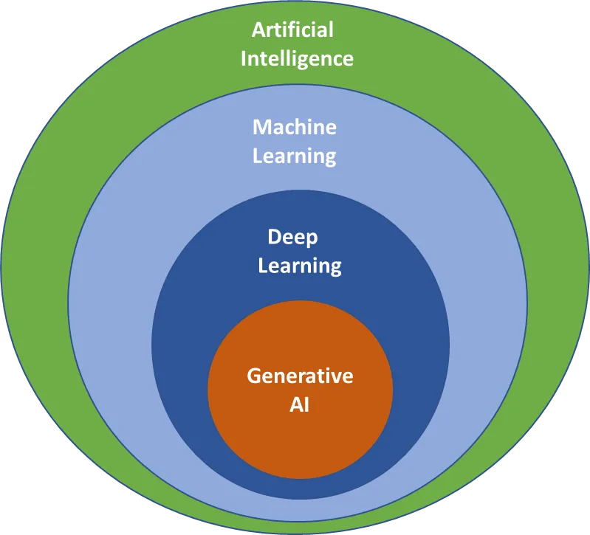
Generative AI
Refers to a branch of AI that focuses on creating new data or content from existing data or content
Differs from other examples of AI and machine leaning (ML) in terms of its goals, methods, and challenges
Generative AI models have transcended mere automation, demonstrating human-level performance in intricate tasks

Slide 4
Possible use of Generative AI

Slide 5
Disruption management-opportunities
Handling information about strikes, delays, special cargo, turbulence, and sustainability-driven selections
Optimize post-disruption communication for improved customer experience
Instantly provide content related disruption details and recommendations for passengers
Analyze data of customers based on urgent needs and provide back these recommendations via human language in order to enhanced assistance for specific groups
Develop and implement most effective recovery measures

Slide 6
Disruption management-challenges
Accurate dynamic data sharing among entities
Ensuring confidentiality, availability, and integrity of the solution and results
Balancing customer expectations for a hybrid human/AI approach
Ensuring accessibility and inclusivity across languages and devices
Implementing industry standards for Generative AI solutions
Data availability from recent events available (e.g. strikes)
Data quality, especially in relation to regulatory requirements

Slide 7
Route optimization-opportunities
improved user understanding of seasonal traffic and weather and other events (e.g. geopolitical, health issues, strikes)
AI-customized subscriptions such as special offer for distressed inventory in travel using LLM for the communication
Determination of most sustainable routing

Slide 8
Route optimization-challenges
Data availability, reliability, and privacy
Security
Generative AI restrictions in countries and companies
Lack of experience regarding the acceptance of these types of offers, or assessment of how well AI-created solutions align with consumer preferences or regulatory requirements

Slide 9
Workforce training/coaching-opportunities
Provide users comprehensive personalized career training plan using already existing predictive models based on industry developments
Generating exams, tests, training material
Guiding employees career paths, identifying strengths, providing development plan proposals, addressing weaknesses
Recommendation of tailored training courses automatically adapted and enhanced based on user’s feedback
Enhance talent attraction and retention through improved training experiences
Constant AI coaching, mentoring – no-shame access to knowledge

Slide 10
Workforce training/coaching-challenges
Data protection - clarity on what happens with data and who has access to it
Quality, need for constant human assessment and validation
Corporate responsibility and governance
Nurturing training - empathy, human touch, changes in the experience
Devalued training perception
Ensuring that the AI data is updated, and that all data is captured
Learning experience, physical to virtual – change in training methodology
Fixed and initial costs

Slide 11


Cybersecurity
Obvious concerns related to IT systems
GNSS interference the main issue at the moment

Slide 12

.
Thank you

Slide 13

Thank you
prolas@iata.org

